Slide 1
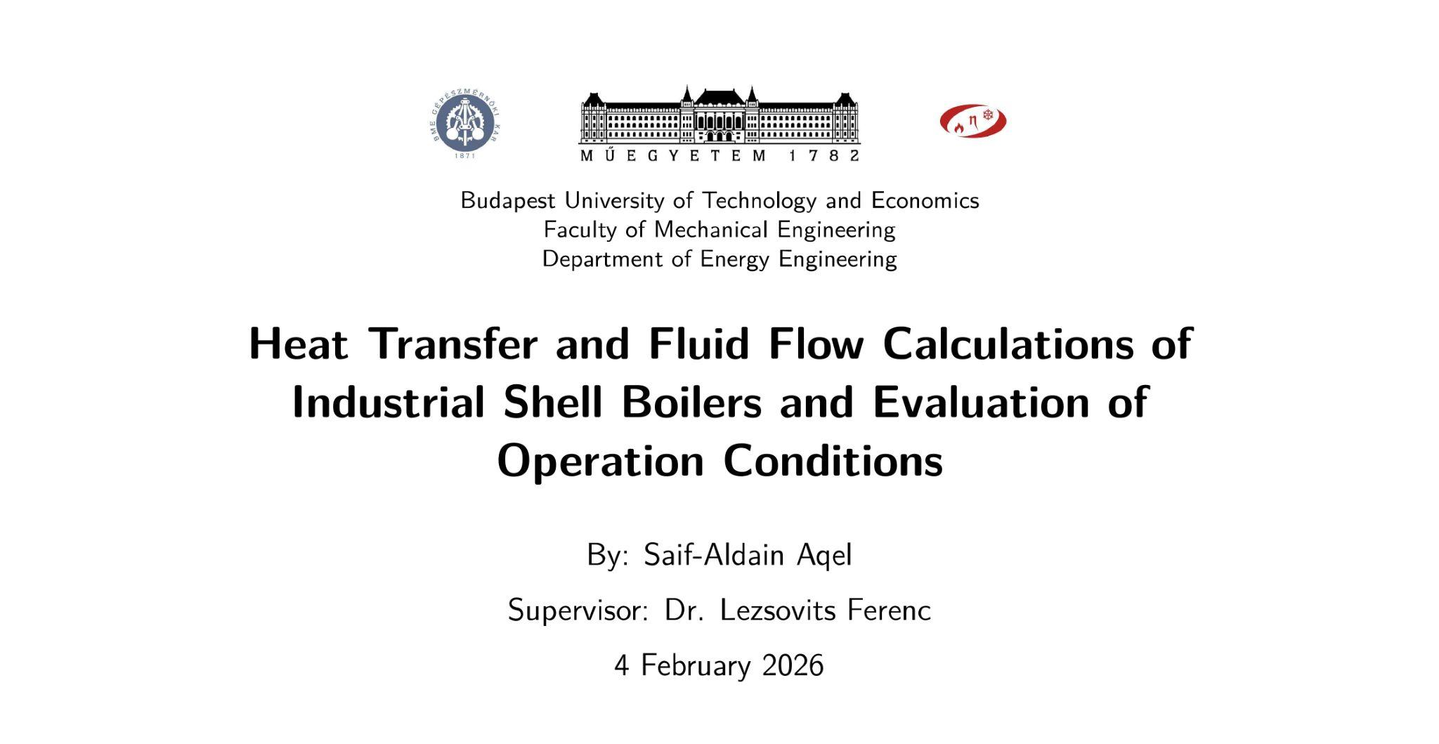

Slide 2
Problem Statement
Problem
Goal
Fire-tube boiler performance is usually evaluated with lumped, empirical methods that do not show where heat is transferred or lost inside the boiler, limiting targeted efficiency improvements.
To develop a model of a three-pass fire-tube boiler that couples combustion, heat transfer, and hydraulics to predict efficiency, steam production, and pressure losses.

Slide 3

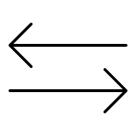

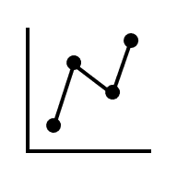
Objectives
Background
Configuration
Burner
Review industrial applications in energy supply
Select shell boiler design
Model gaseous fuel combustion
Heat Exchanger
Performance
Sensitivity Analysis
Model heat transfer and hydraulics
Evaluate overall boiler performance
Investigate key operating parameters

Slide 4
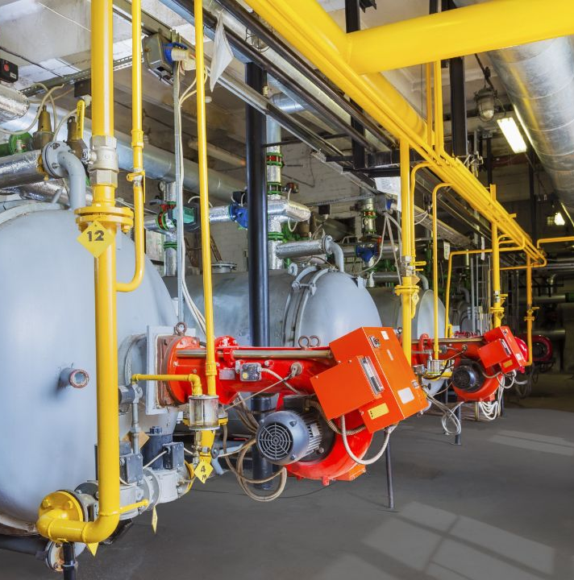
Background
Widely used in small to medium industrial plants
Compact, packaged, and easy to operate
Applied in food, chemical, pharma, healthcare, and general industry
Typical pressure: 6–25 bar
Typical capacity: ~0.5–20 t/h
Three-pass designs common for higher efficiency

Slide 5
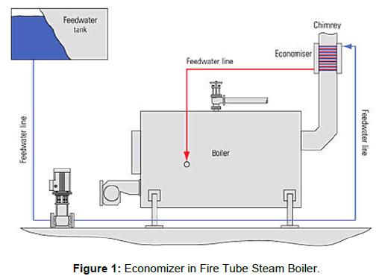
Boiler Setup

Slide 6
Configuration
1st Pass
1st + 2nd Reversal
2nd + 3rd Pass
Single large fire tube
1.4 m inner diameter, 5.3 m length
Main combustion chamber inside the shell
Two wet-back reversal chambers
1.6 m inner diameter, 0.8 m length each
Turn flue gas 180° between passes
Two staggered fire-tube banks
118 and 100 tubes
76 mm inner diameter tubes
Main convective heat-transfer surface
Economizer
Drum
Streams
External shell-and-tube heat exchanger
120 tubes, 25 mm inner diameter
80 m total tube length
Feedwater preheating section
Horizontal pressure vessel
4.5 m inner diameter, 5.0 m length
Encloses water submerged furnace and tube banks
Fuel and air enter at burner
Flue gas flows through passes and economizer
Feedwater enters via economizer before drum

Slide 7
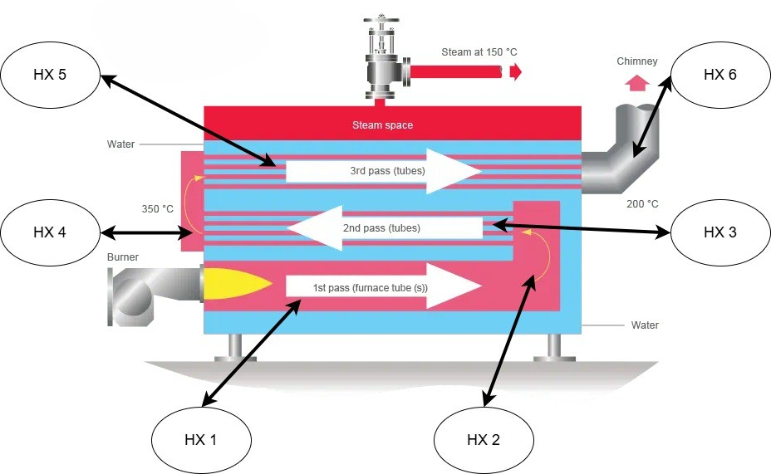
Boiler Stages

Slide 8
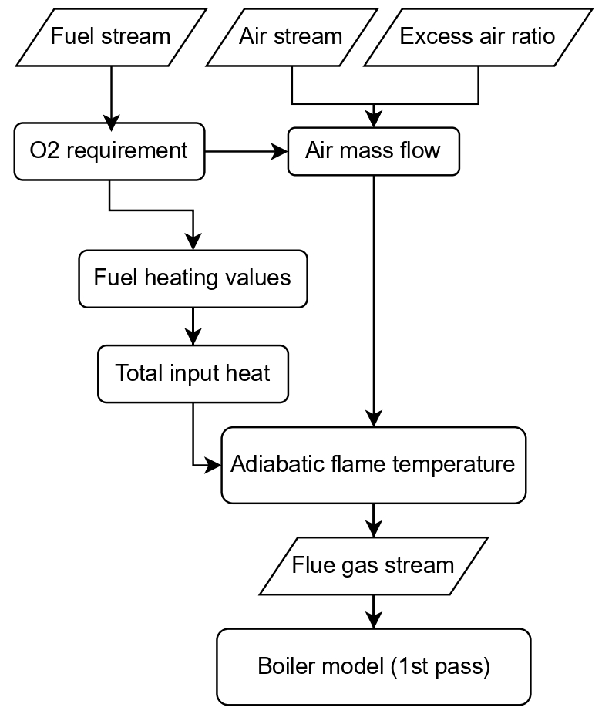
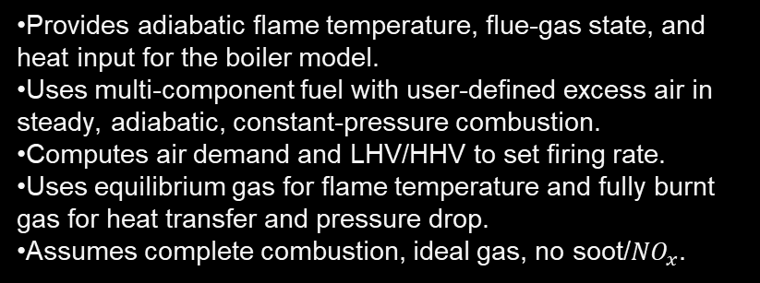
Combustion

Slide 9

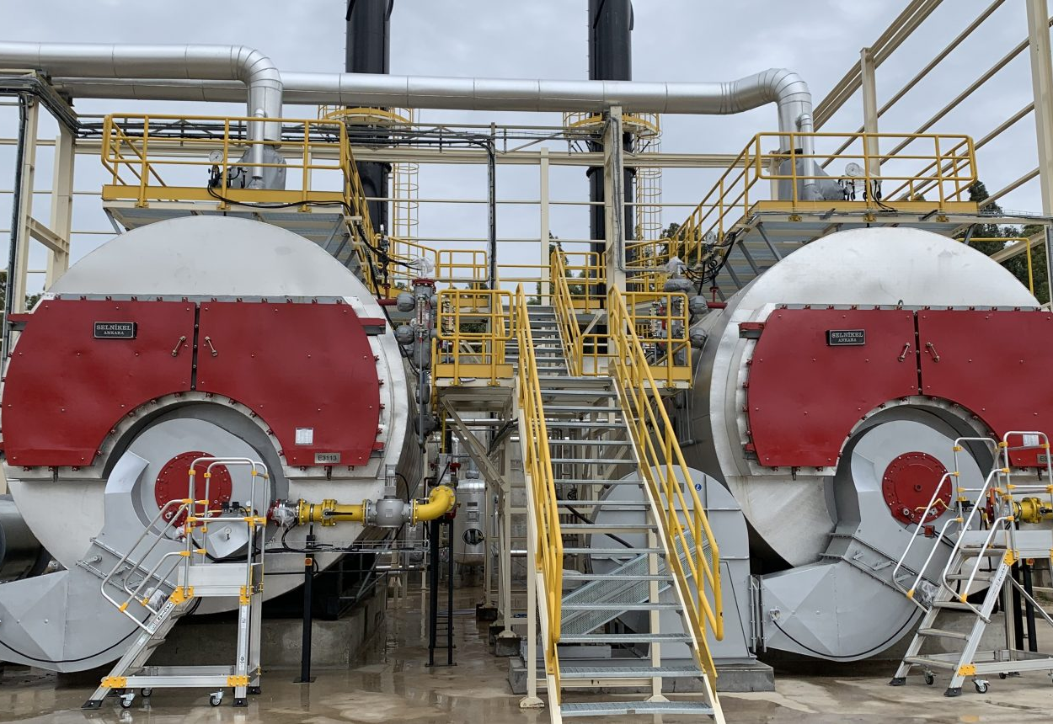
Heat
Exchanger

Slide 10
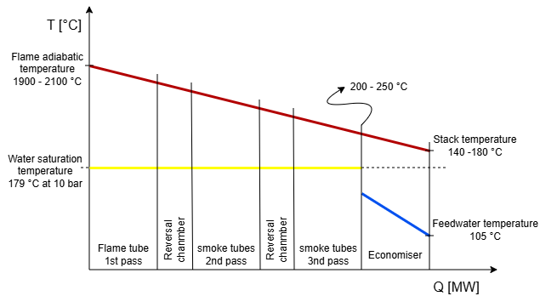
Model Framework
Each of the six stages is split into small segments and solved by marching along the gas path.
At each segment, heat transfer is evaluated using a resistance network, and wall temperatures are iterated until the wall heat flux and temperature drops are consistent.
Hydraulics are solved concurrently as frictional, minor losses, and drag.
Pressure is updated step-by-step and fed back into property evaluation, so pressure-dependent properties change velocities and loss terms, keeping heat transfer and pressure drop coupled.
Heat-transfer and pressure-loss models are selected by exchanger section and flow regime; ensuring the governing physics is applied where it is relevant.

Slide 11
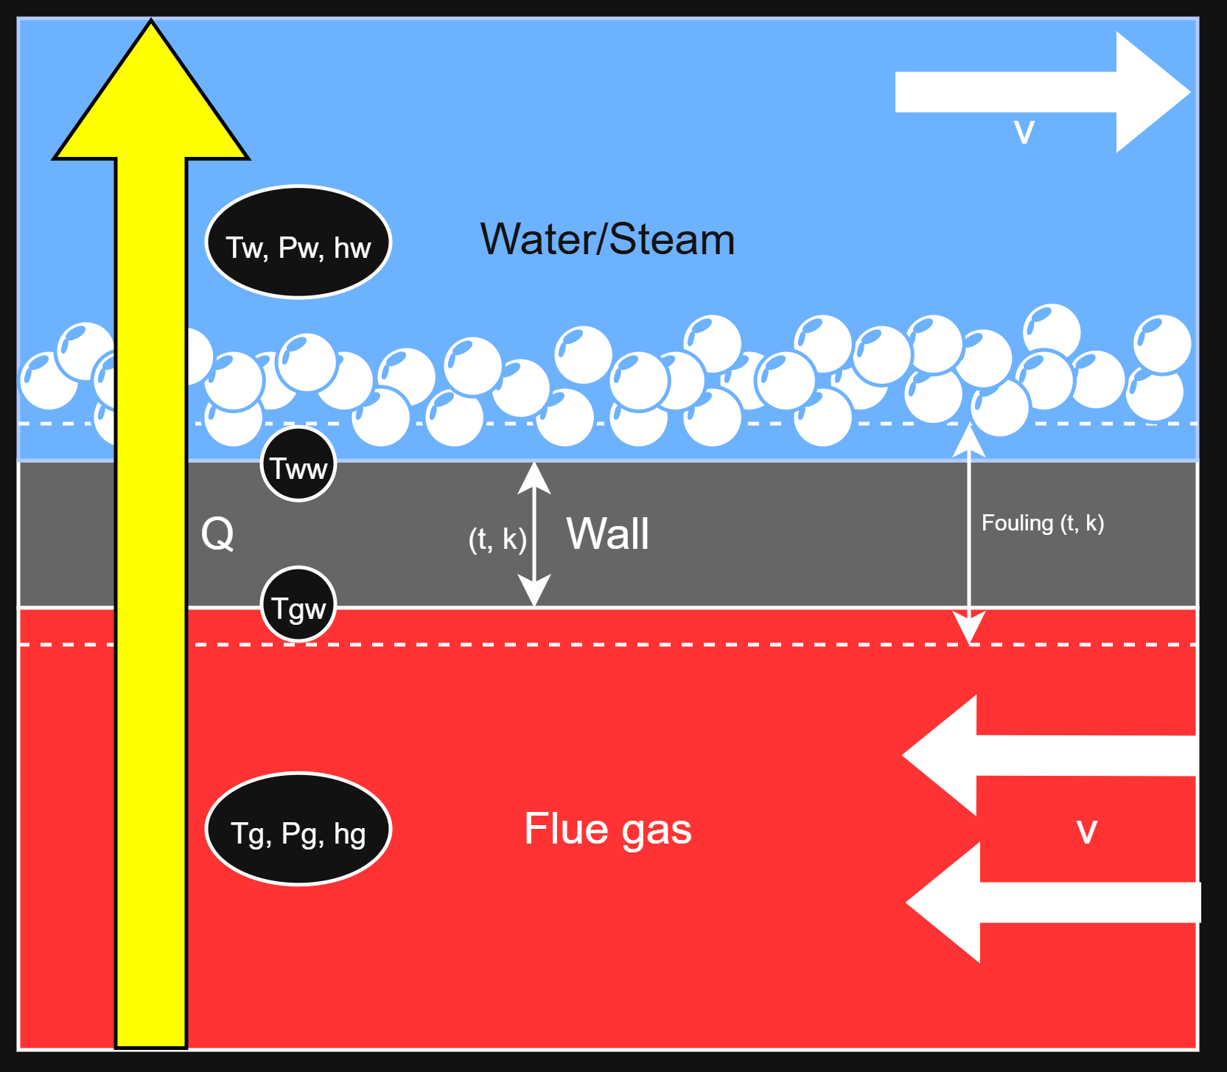
Heat Transfer and Hydraulics
Resistance network: Uses a layered thermal-resistance chain from gas → fouling → tube wall conduction → fouling → water/steam.
Gas-side: Heat transfer includes both convection and gas radiation; pressure losses from internal-flow friction and minor losses (discharge, bends, expansions), with the economizer treated separately using tube-bank bundle drag for crossflow.
Water-side: Pressure-part sections are modeled using saturated pool boiling, while the economizer is treated as single-phase internal flow; pressure drop is calculated from frictional and minor losses in the economizer, with negligible hydraulic losses assumed in the boiling sections.
Gas-side dominance: The overall heat-transfer rate is primarily governed by the gas side because gas-side thermal resistance is much larger and more variable than the water/steam-side resistance.

Slide 12
Performance
Variable | Meaning
Useful heat output (MW) | Total heat transferred to water/steam (all stages)
Fuel heat input (MW) | Thermal input from fuel (LHV basis)
Boiler efficiency | Direct and indirect efficiency
Steam production (t/h) | Steam capacity from absorbed heat
Stack temperature (°C) | Flue-gas outlet temperature
Stack loss fraction (–) | Fraction of input heat lost with flue gas
Gas-side ΔP (kPa) | Total gas pressure drop (boiler + economizer)
Water-side ΔP (kPa) | Water pressure drop in economizer

Slide 13
Nominal Operation (Control Case)
Operating Conditions |  |  |  | Combustion
Fuel | λ | Drum P | FW Inlet T | Air Flow | T_ad
0.10 kg/s | 1.05 | 10 bar | 105 °C | 1.69 kg/s | 1982 °C
Thermal Performance
Firing (LHV) | Useful Heat | Steam | η (dir/ind) | Stack T | Stack Loss
4.67 MW | 4.42 MW | 6.81 t/h | 95 % | 152 °C | 5 %
Hydraulic Performance
ΔP Gas | ΔP Fric | ΔP Minor | ΔP Water | ΔP Fric | ΔP Minor
12.45 kPa | 8.35 kPa | 4.09 kPa | 0.06 kPa | 0.06 kPa | 0.0001 kPa

Slide 14
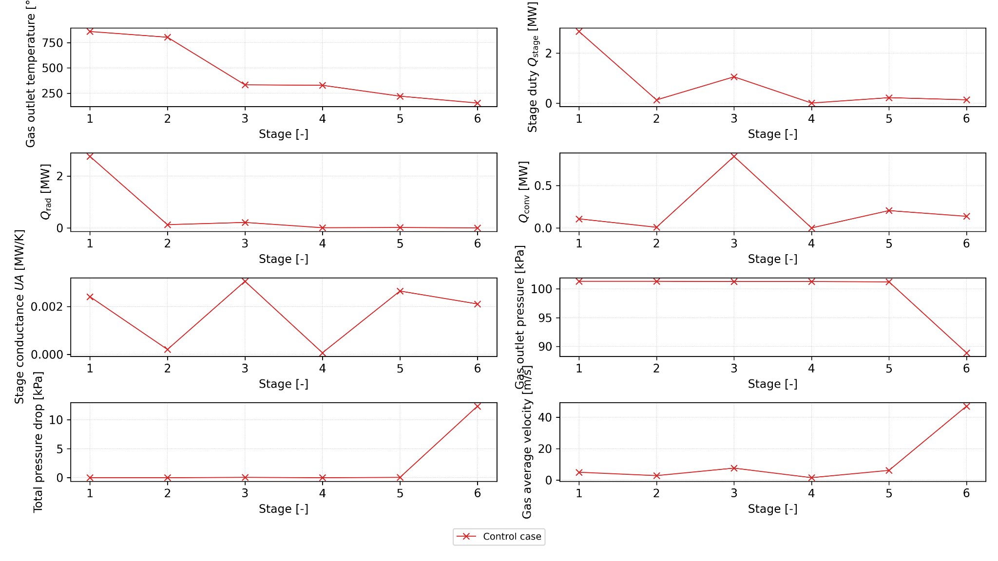
Stage-wise heat transfer and hydraulics (Nominal)

Slide 15



Analysis Methodology
The excess air factor (λ) was varied to study its effect on combustion and efficiency.
λ
Excess Air Ratio
The fuel mass flow rate was varied to study boiler load and thermal response.
Firing Rate
The drum pressure was varied to study its impact on steam generation and efficiency.
Drum Pressure
The fouling factor was varied to study the effect of fouling on heat transfer and efficiency.
Fouling

Slide 16
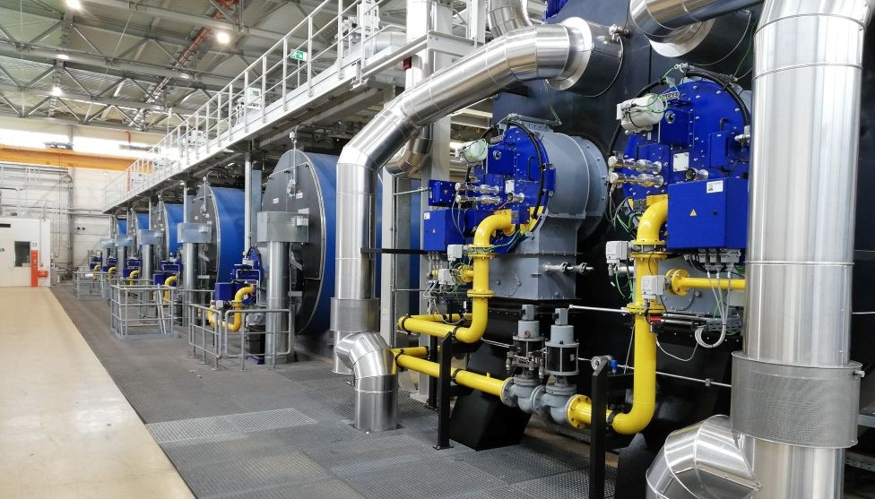
Results

Slide 17
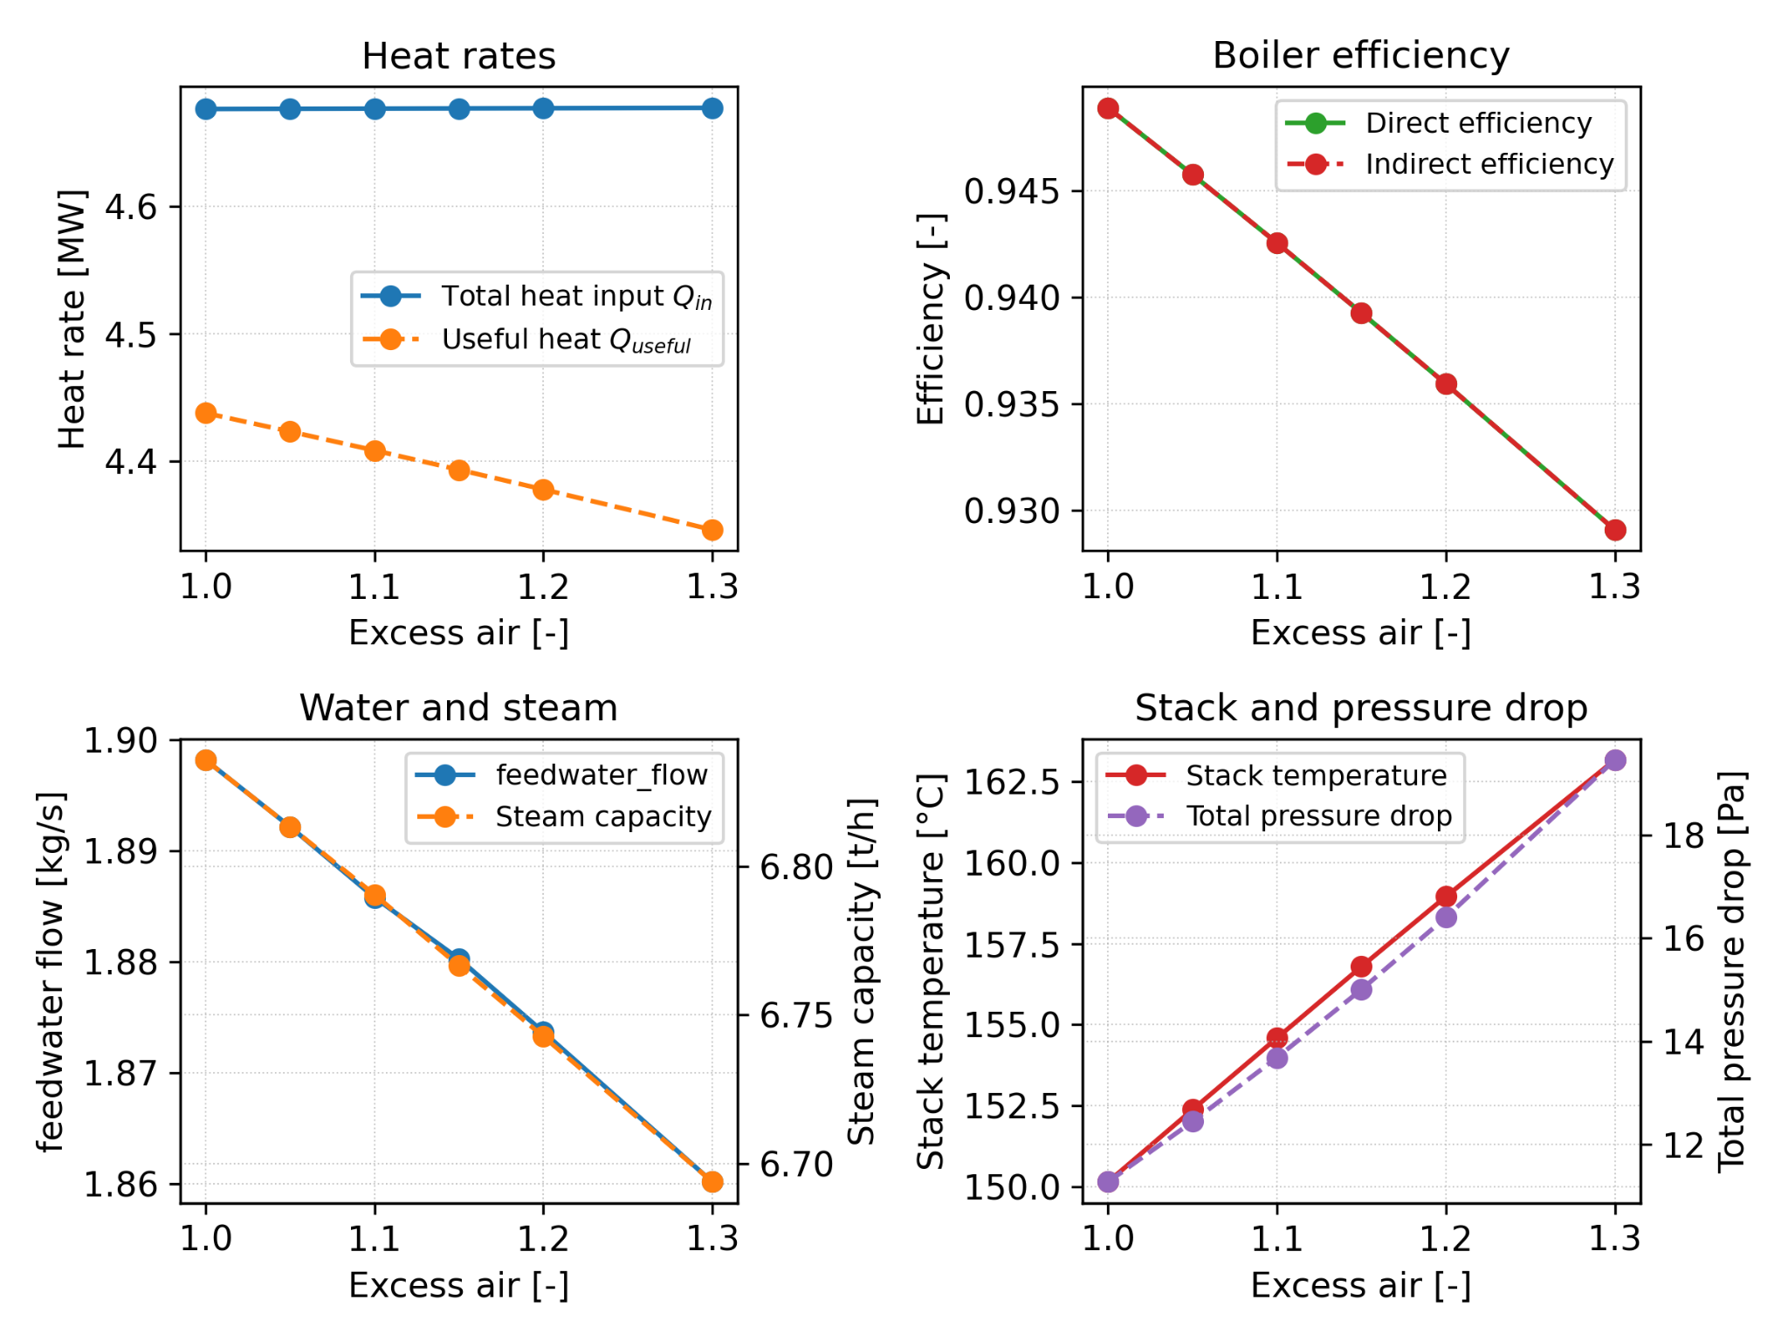
Excess Air Ratio
Controls flame temperature and flue-gas mass flow
Clear efficiency optimum near nominal setting
Higher excess air increases stack losses and pressure drop
Shifts heat transfer toward downstream stages

Slide 18
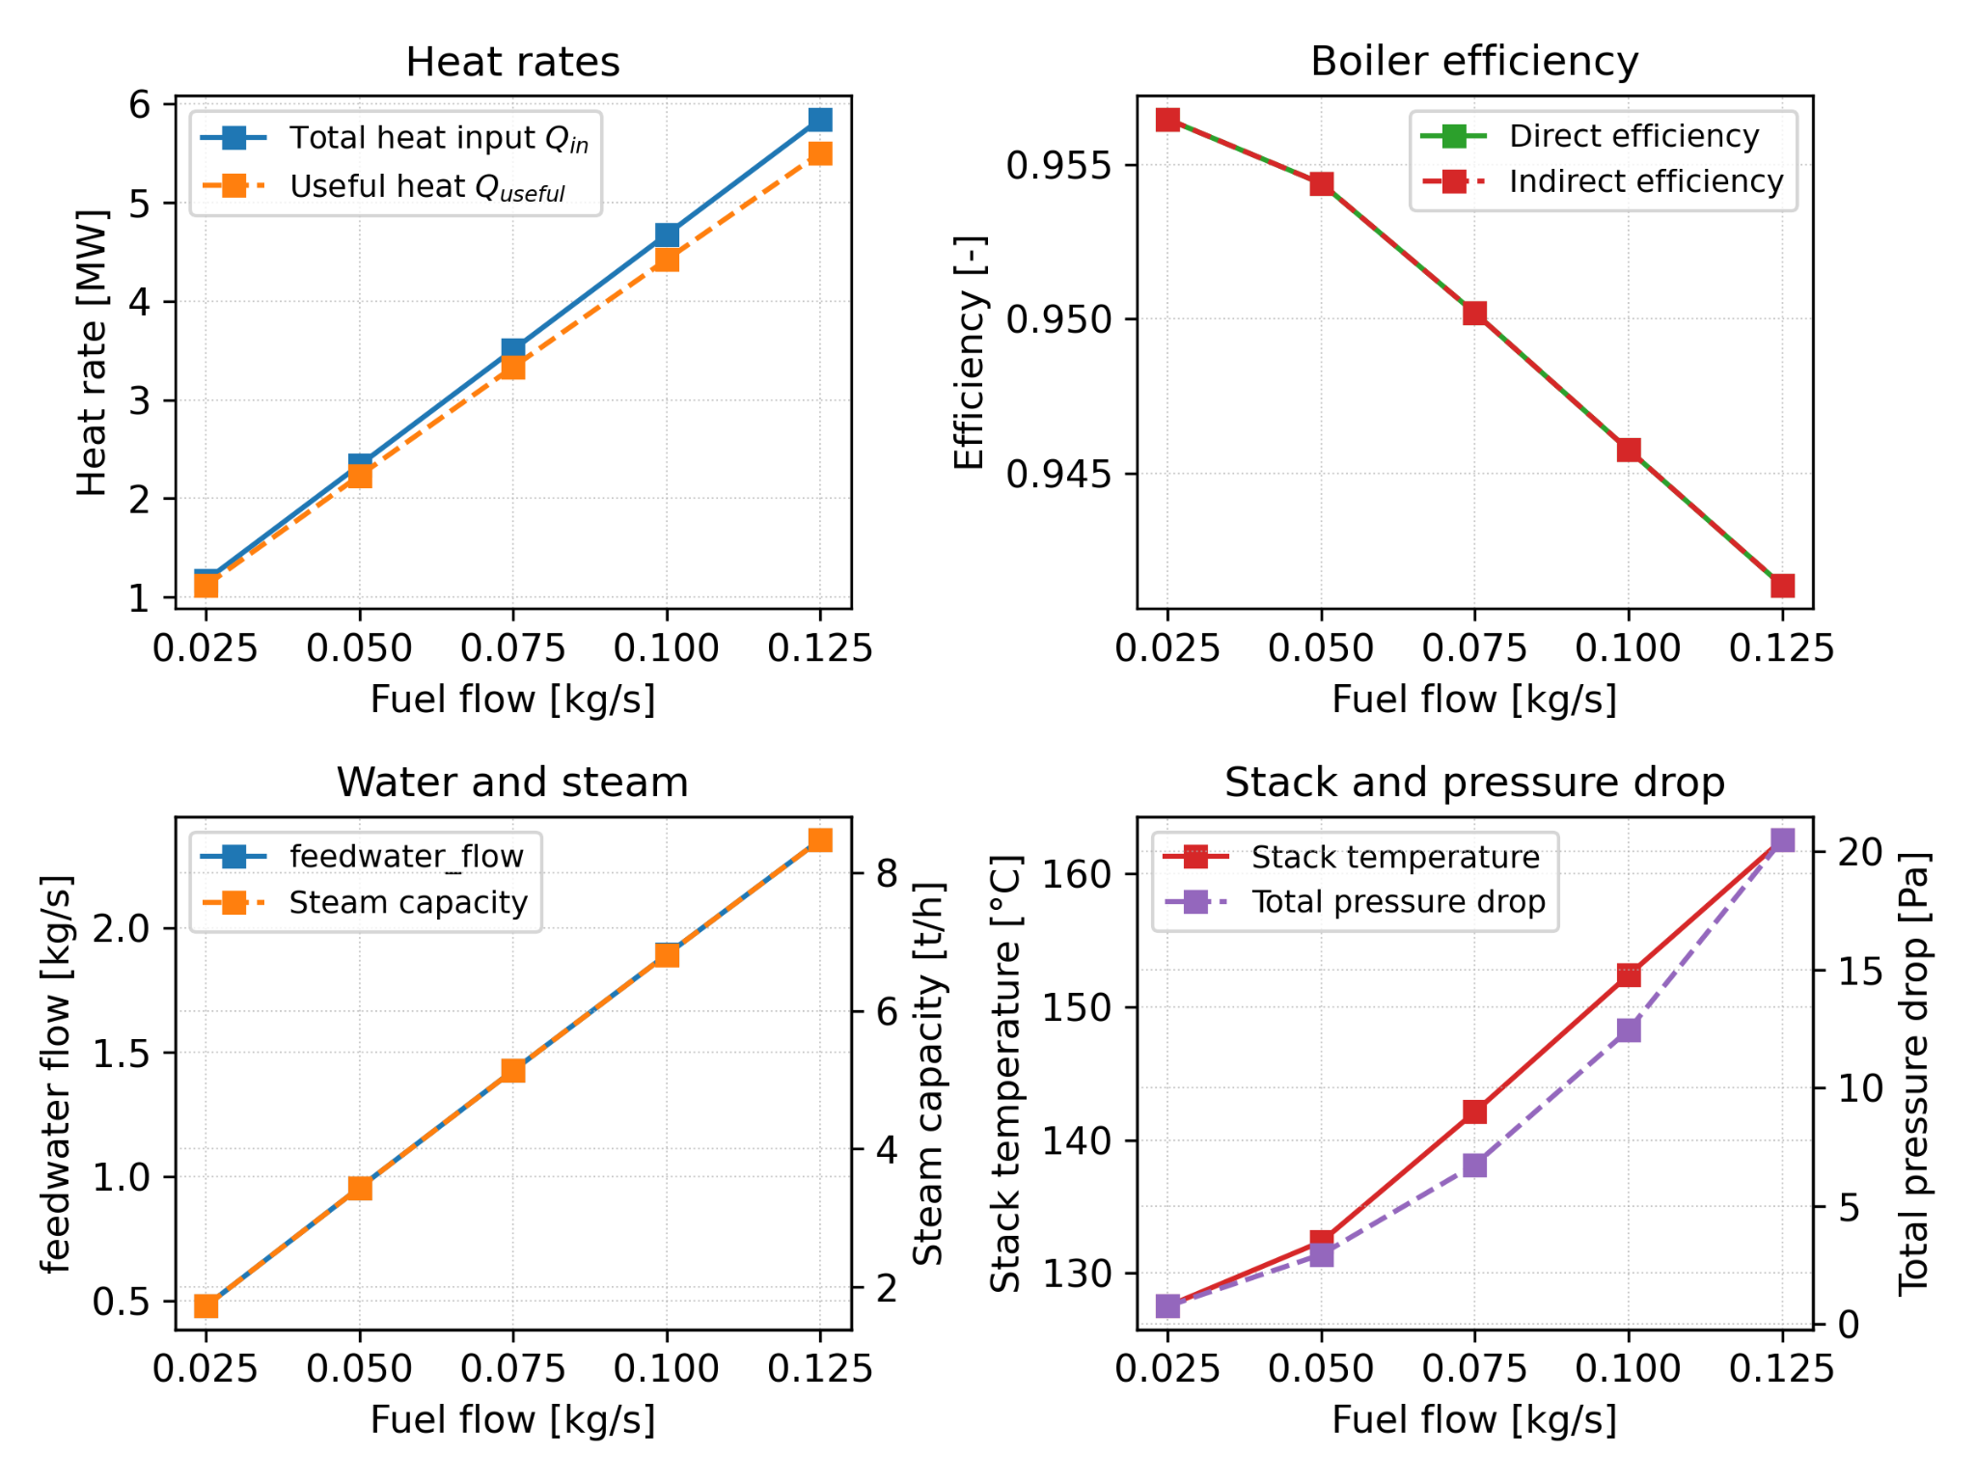
Firing Rate
Primary parameter for load and steam capacity
Steam production scales approximately linearly with fuel input
Efficiency nearly constant over practical load range
Higher firing rate increases gas velocities and pressure losses

Slide 19
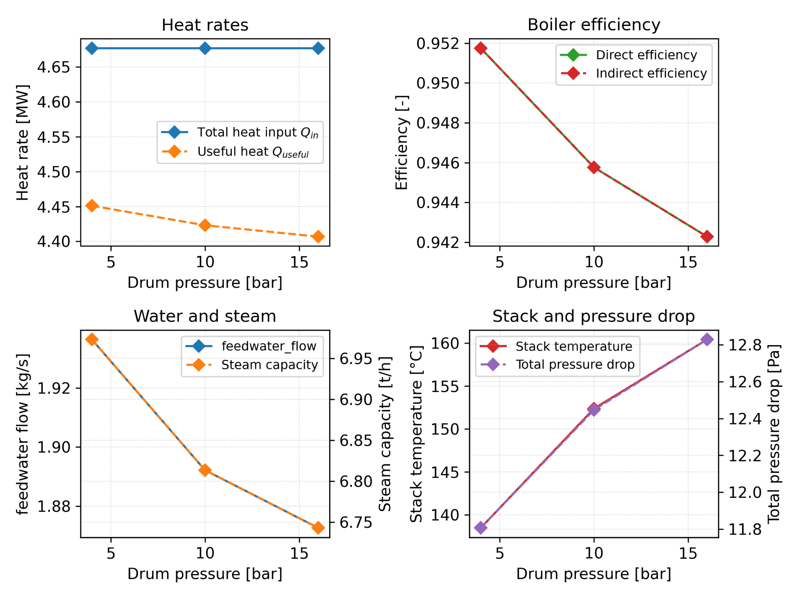
Drum Pressure
Sets saturation temperature and latent heat of evaporation
Higher pressure reduces gas–water temperature driving force
Mainly affects steam quantity rather than efficiency
Leads to higher stack temperatures at elevated pressure

Slide 20
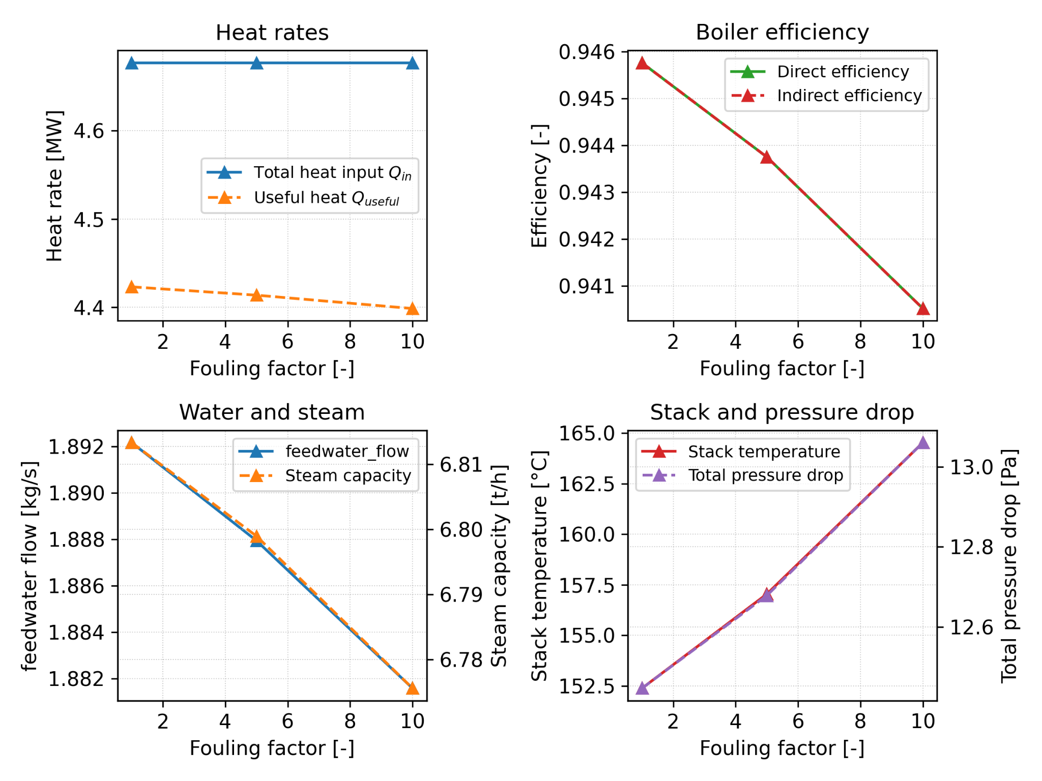
Fouling
Increases thermal resistance on heat-transfer surfaces
Reduces effectiveness of downstream convective sections first
Causes higher stack temperatures and lower efficiency
Emphasizes importance of cleaning and maintenance

Slide 21
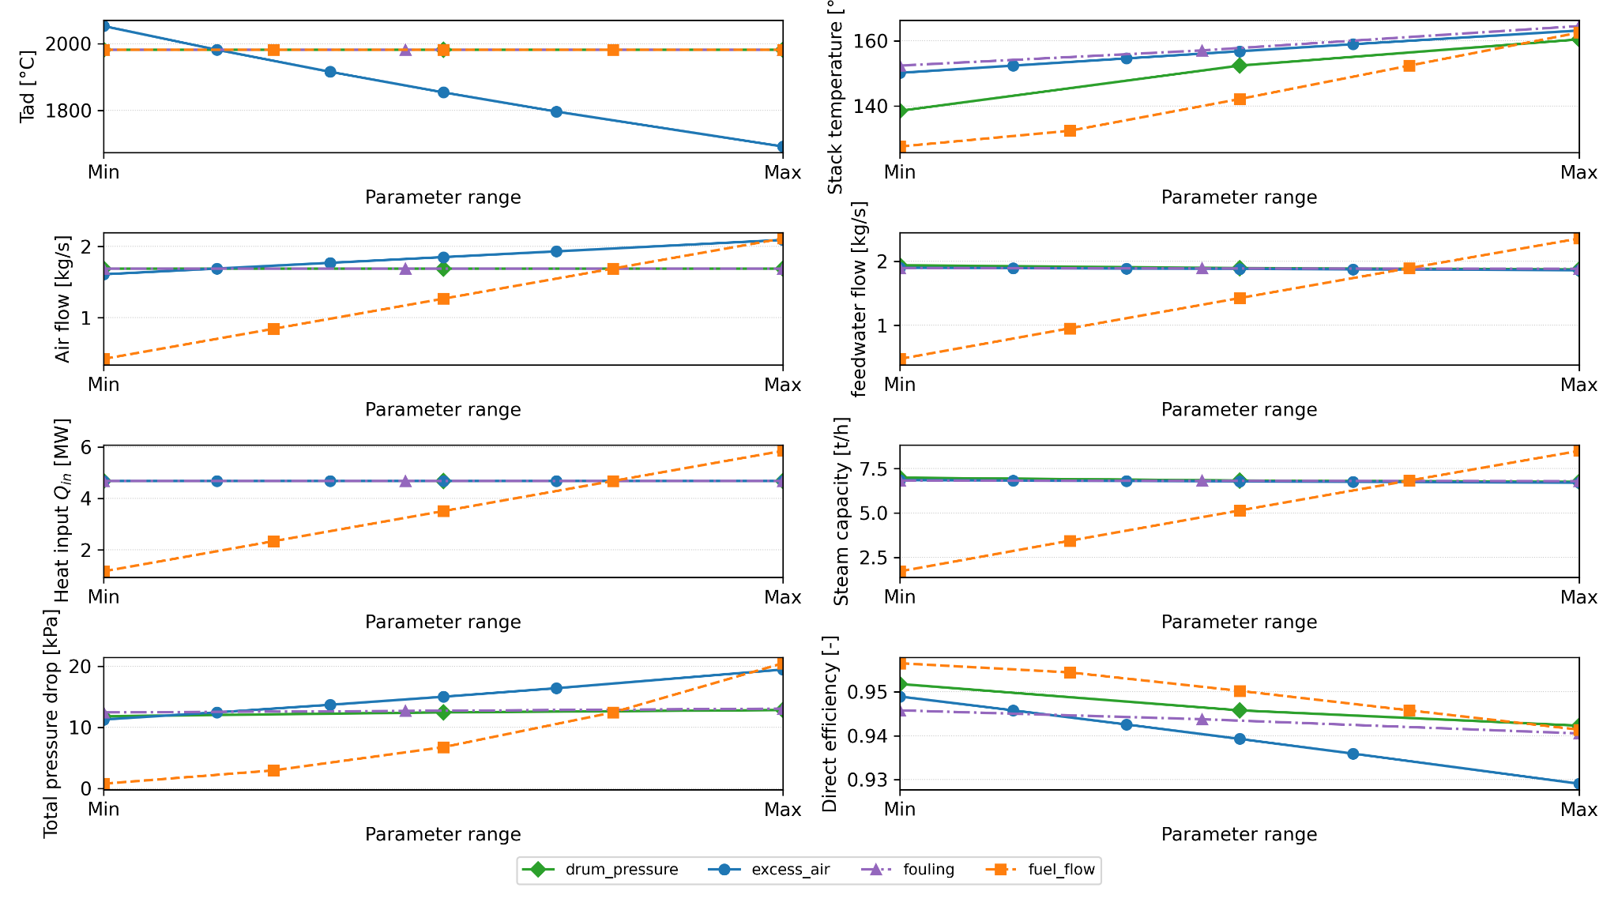
Performance Results for All Parameter Groups

Slide 22
Summary
This project is a physics-based, integrated model for a three-pass fire-tube boiler.
Used a Python 1-D marching solver coupling combustion, heat transfer, and hydraulics.
Excess air ratio is the key efficiency driver (flue gas flow, flame temperature, stack losses).
Firing rate controls thermal duty and steam production.
Drum pressure mainly affects steam quantity; higher pressure slightly lowers efficiency.
Model enables consistent performance analysis and operational trade-off assessment.

Slide 23
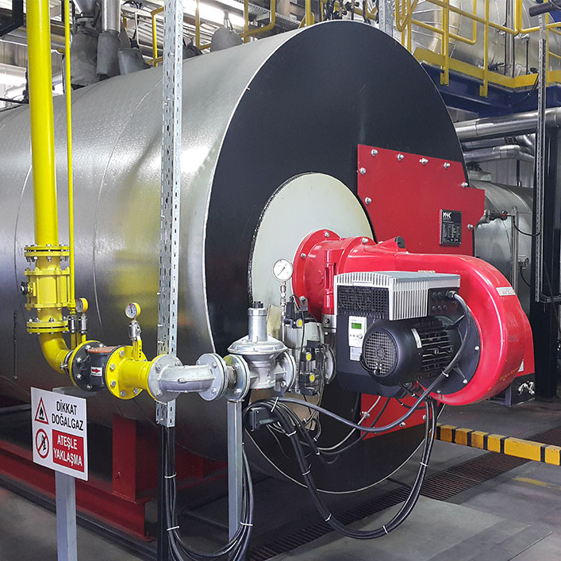
THANK YOU!

Slide 24
Q1) On Fig.8.2. is there any difference in between feedwater-flow and steam capacity? If yes, why?
The steam capacity is the rate of steam produced and delivered by the boiler.
The feedwater flow is the rate of water supplied to the boiler to maintain drum inventory.
Blowdown is the intentional discharge of a small amount of boiler water to remove accumulated dissolved solids and prevent scaling, foaming, and tube overheating.
Due to Blowdown and Leakage → Feedwater flow > steam capacity.

Slide 25
Q2) In the chapter of 8.2.4. fouling is on water or in flue-gas side, or in both? Which fouling gives higher risk in operation and why?
Fouling is included on both sides.
Water-side fouling is more critical because it insulates the tube from boiling water, raising metal temperature and increasing the risk of overheating, material degradation, and tube rupture.
Gas-side fouling mainly reduces heat transfer and increases stack temperature and fuel consumption, but it is usually less immediately dangerous to boiler integrity.

Slide 26
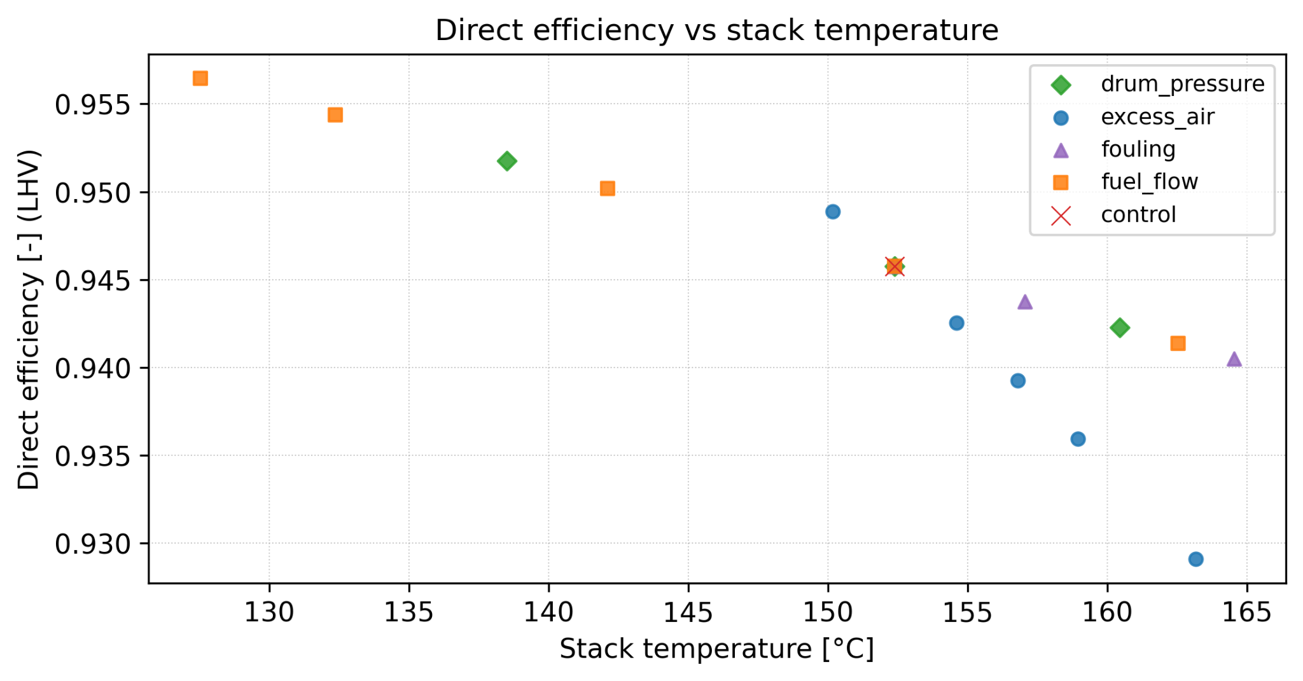
Q3) Explain the information given by Fig. 8.7. What cases are shown by different colours and signs?
The figure presents clusters of operating points, where each parameter group is identified by a unique combination of color and symbol, allowing comparison of relative trends and data dispersion between cases.
It is intended for qualitative comparison rather than defining explicit minimum or maximum operating limits, showing the trends of different operating cases.

